Slide 1

Maps for HTML Community Report
2021-06-24

Slide 2
Table of Contents
Workshop
Accessibility
UCR Fulfillment Matrix
Custom Projections
Linking Spatial Data – The GeoWeb
Shared Platform Primitives - APIs
https://www.w3.org/community/maps4html/2021/05/27/winter-2021-report/

Slide 3
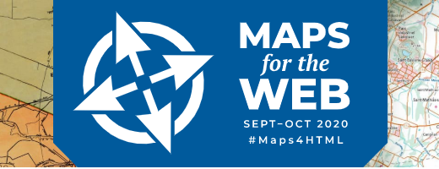
Status
Workshop Report: https://www.w3.org/2020/maps/report
Notes:
In September 2020 we held the first virtual world-wide joint workshop of the W3C and OGC and Web mapping communities. The results were quite positive. The workshop is summarized by a report linked here. The testimonials of the participants provide evidence of need, indeed many presentations were about what the requirements for accessible maps should be.

Slide 4
Accessibility Comes First
<feature zoom= "12">
<featurecaption>An accessible feature name</featurecaption>
<properties><h1>HTML-valued properties</h1></properties>
<geometry cs="gcrs">
<a href="#4,-78.23856,60.15809">
<point><coordinates>…</coordinates></point>
</a>
</geometry>
</feature>

Slide 5

Accessibility Comes First
Notes:
https://youtu.be/iWSX9-72wsE

Slide 6
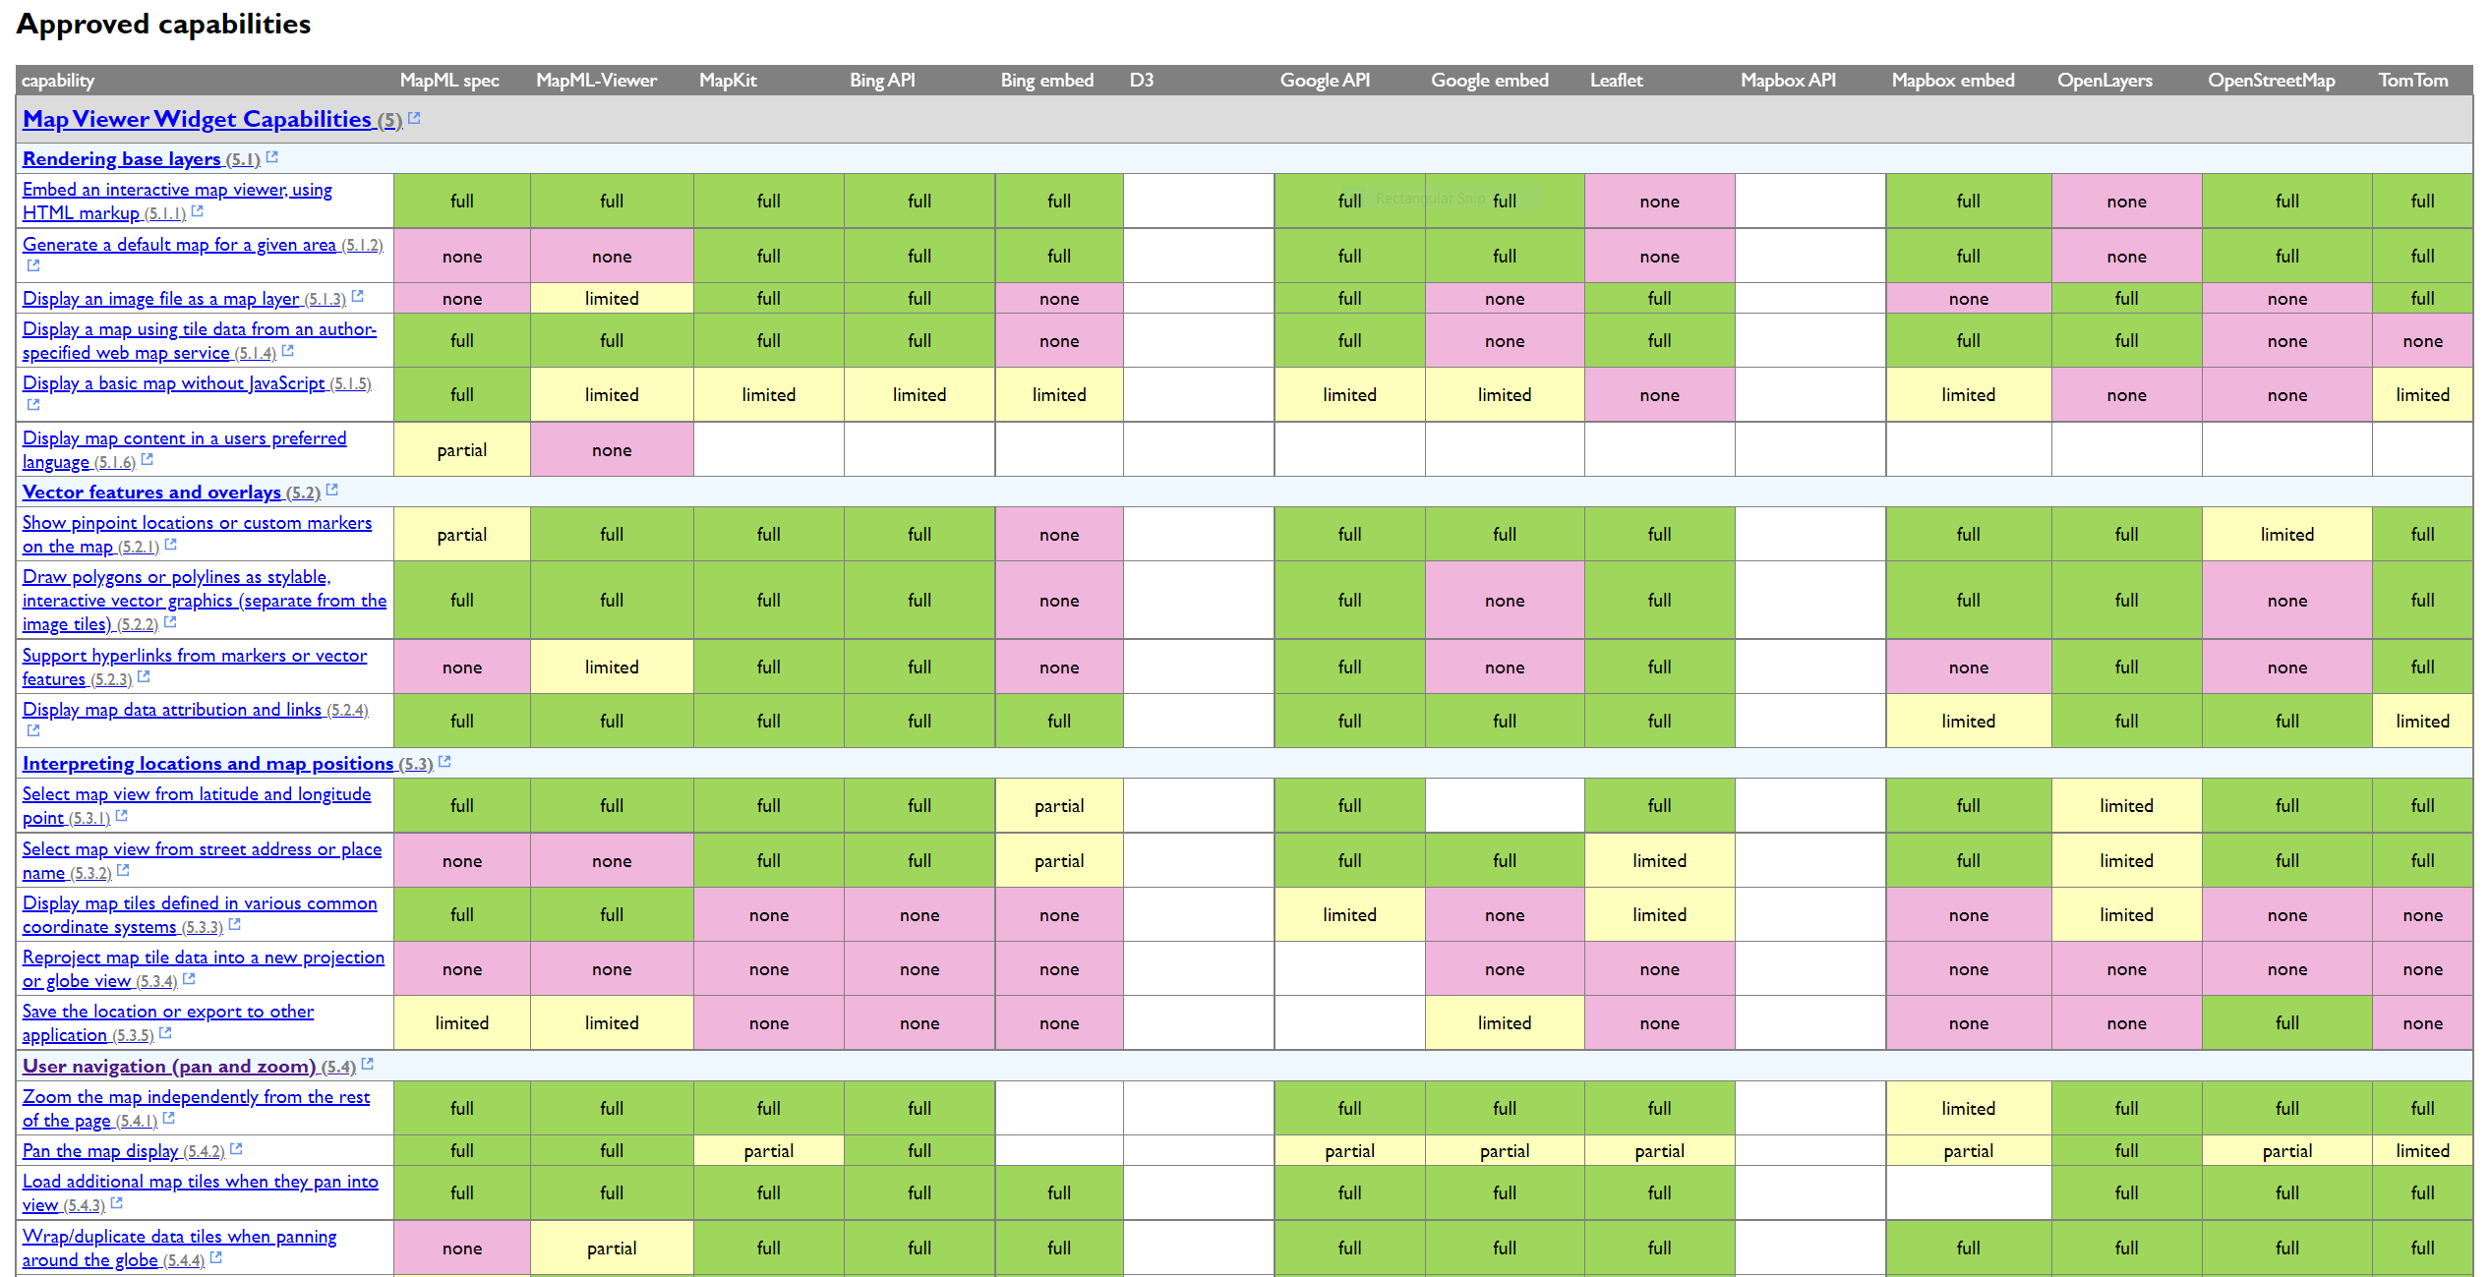
Requirements Fulfillment Matrix
Help Wanted
Looking for an editor, to help to continue editing and tabulating requirements, capabilities
https://maps4html.org/UCR-MapML-Matrix/mapml-ucrs-fulfillment-matrix.html

Slide 7
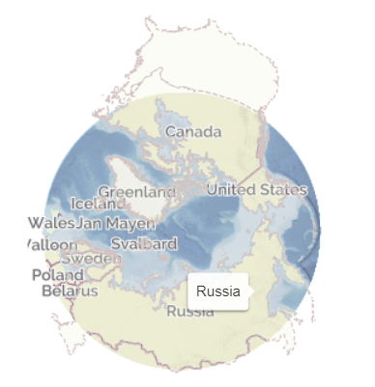
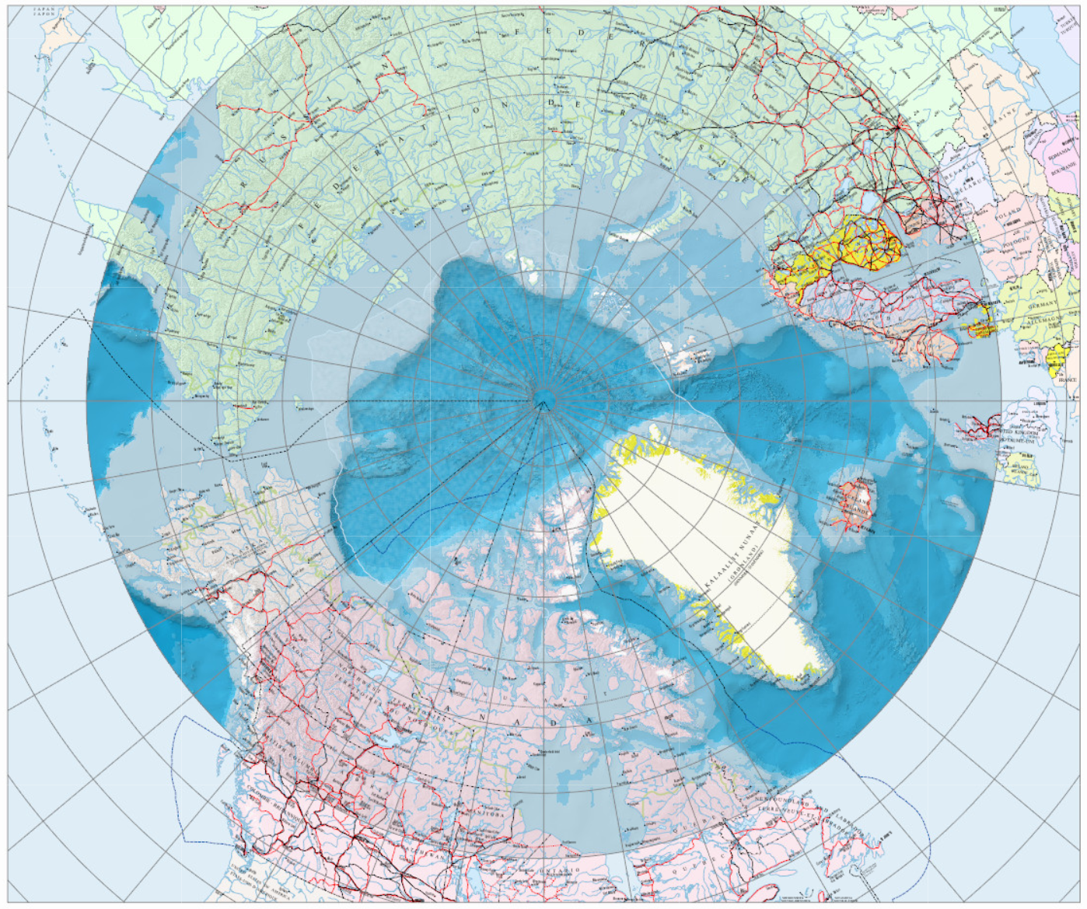
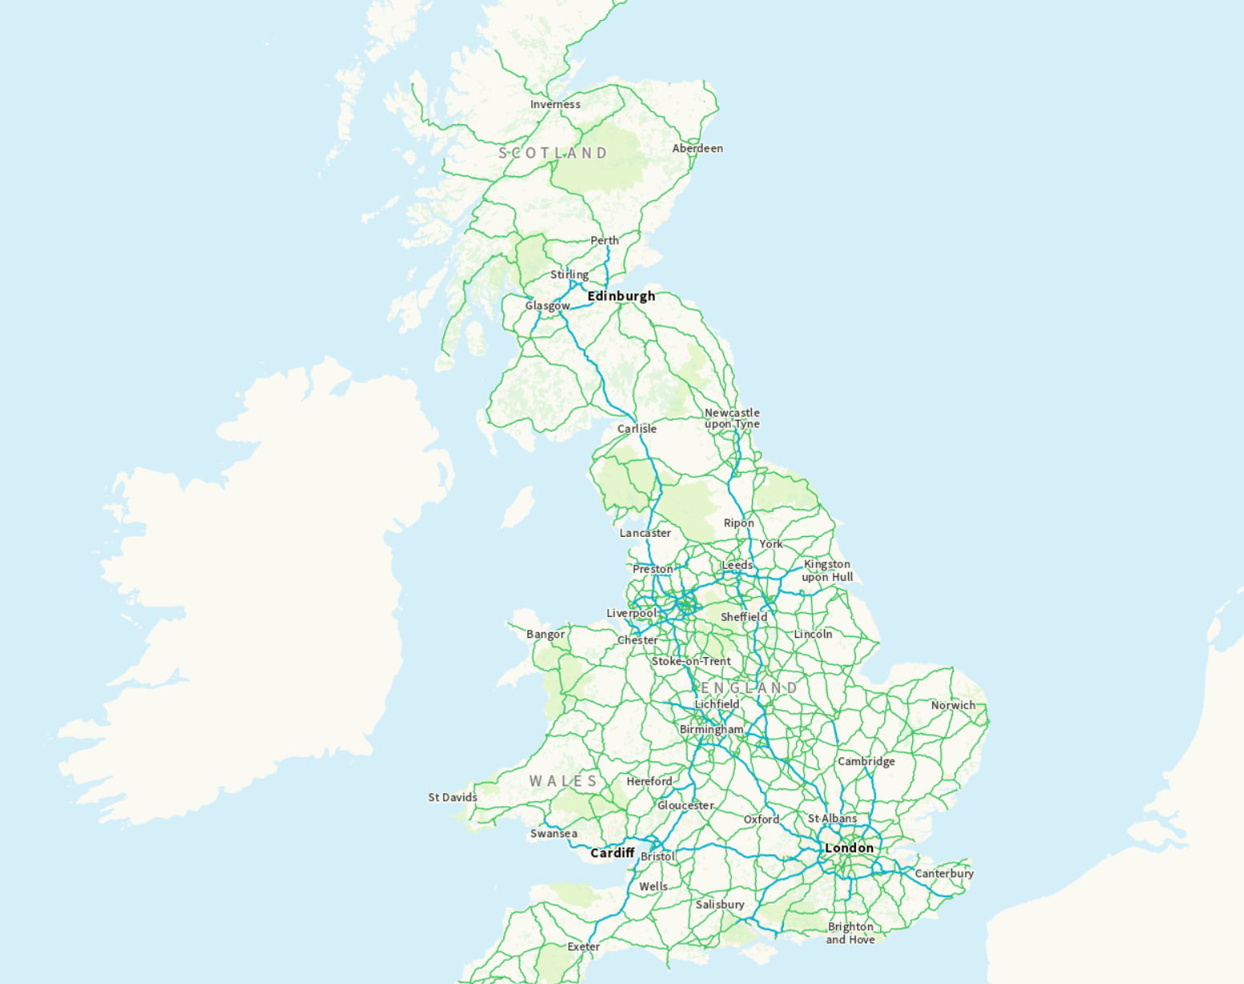
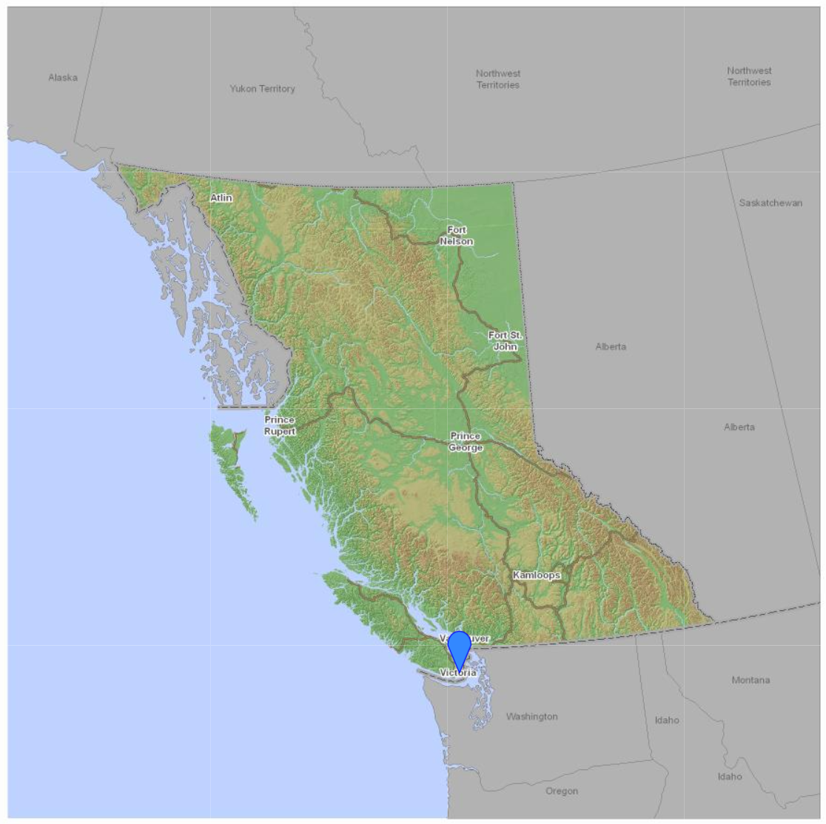
Custom Projections
aeqd
laea
BNG
aea

Slide 8
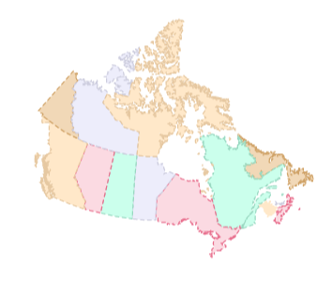
Federated Web Mapping – The GeoWeb
<feature zoom="12">
<featurecaption>An accessible feature name</featurecaption>
<properties><h1>HTML-valued properties</h1>…</properties>
<geometry cs="gcrs">
<a href="#4,-78.23856,60.15809">
<point><coordinates>…</coordinates></point>
</a>
</geometry>
</feature>

Slide 9
Changing Projection on Zoom / Map State Change
<mapml lang=“en" xmlns="http://www.w3.org/1999/xhtml/">
<head>
<title>Canada Base Map - Transportation (CBMT)</title>
<meta charset="utf-8"/>
<link rel="zoomin" href=“openstreetmap.mapml" />
<link rel="zoomout" href="/experiments/linking/features/canada.mapml" />
</head>
<body>
<extent units="CBMTILE" >
<input name="z" type="zoom" min="6" max="8"/>
<input name="y" type="location" units="tilematrix" axis="row"/>
<input name="x" type="location" units="tilematrix" axis="column"/>
<link rel="tile" tref="https://geoappext.nrcan.gc.ca/arcgis/rest/services/BaseMaps/CBMT3978/MapServer/tile/{z}/{y}/{x}?m4h=t" />
</extent>
</body>
</mapml>

Slide 10
Other Benefits of Linking Geospatial Data
Projection negotiation - demo
Alternate basemap / map layer style selection - demo
Layer style preference negotiation (accessibility)
SEO / decision making - video demo

Slide 11
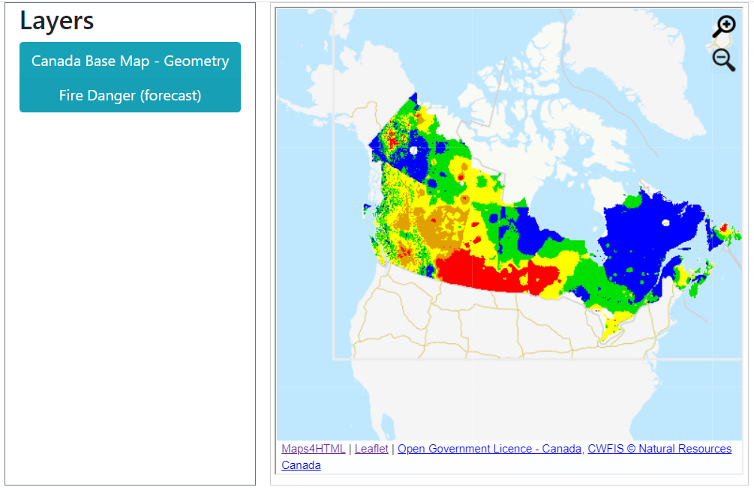
Shareable Primitive APIs
Map customization - demo

Slide 12
Shared (shareable) Primitives: APIs
<head>
<meta charset="utf-8">
<title>British National Grid custom projection</title>
<script type="module">
let customProjectionDefinition = `{
"projection": "BNG",
"proj4string" : "+proj=tmerc +lat_0=49 +lon_0=-2 +k=0.999601 +x_0=400000 +y_0=-100000 +ellps=airy +towgs84=446.448,-125.157,542.060,0.1502,0.2470,0.8421,-20.4894 +datum=OSGB36 +units=m +no_defs",
"origin" : [-238375,1376256],
"resolutions" : [896,448,224,112,56,28,14,7,3.5,1.75,0.875,0.4375,0.21875,0.109375],
"bounds" : [[-238375,0],[900000,1376256]],
"tilesize" : 256
}`;
let customProjectionRegistry = window.customProjections;
let cProjection = customProjectionRegistry.defineCustomProjection(customProjectionDefinition);
</script>
</head>
Notes:
EPSG:27700

Slide 13
Thank you! Peter.Rushforth@Canada.ca

